Slide 1
Communicating Ecological and Social Trade-offs Between Land Management Practices
Introduction to Element 011
Sustainable Land Management

Slide 2

Social and ecological trade-offs
Conserving biodiversity and ecosystem services must be a global priority.
But this can create conflict with other societal needs.
Conserve biodiversity or reduce hunger and poverty?

Slide 3
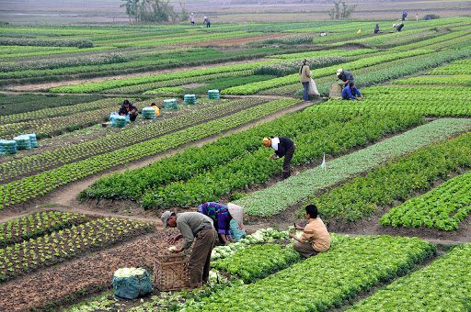
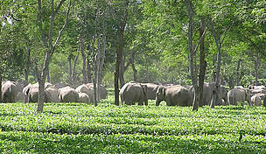
Example ecology vs food production
Food production will always be prioritised.
Would you sacrifice an elephant to protect your crops and feed your children?

Slide 4
Communicating the need for change
Identify your target group.
Consider how they interact with and value nature.
Tailor your messaging to address their key concerns.
This assignment is designed to develop your communication skills and to help you adapt your style and messaging to different target audiences.

Slide 5
Element 011
Task 1 - Video presentation the general public or client(2 minutes: 40% of element)
Task 2 - Letter to local authority (1,000 words max: 60% of element)
Tasks 1 and 2 must be completed and submitted via canvas by 14.00 on 7th April 2022.

Slide 6
TASK 1: Video Presentation General Public
You are required to produce a 2-minute video aimed at convincing the general public that the Cherry Hinton Chalk Pits should not be developed or proposed improvements to ecology at the McCormick factory development site.
Refer back to the information that you reported in your Ecological Impact Assessment – but repackage it for the new audience
Make notes on the customer requirements at the McCormick site.

Slide 7

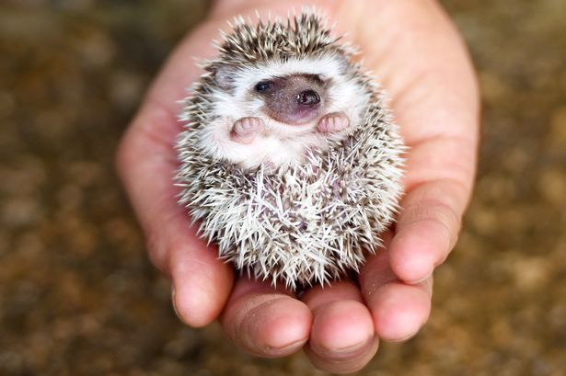
How to make your video
Smart Phone piece to camera
PowerPoint presentation.
Be Creative!

Slide 8
How to get top marks
Explain the value of the site in terms of biodiversity and ecosystem service provision. Explain the added value of putting together a biodiversity scheme for McCormick
Build a convincing argument about why the site should be protected or improved (McCormick).
Be clear and concise.
Use non-specialist language
Be creative!

Slide 9

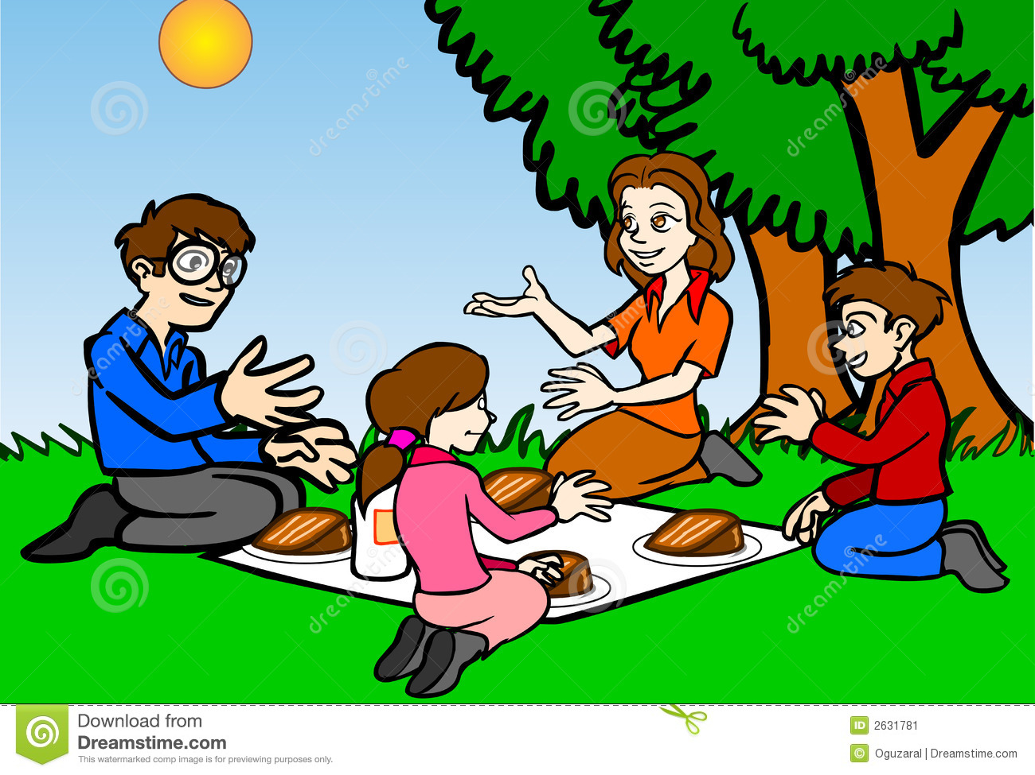
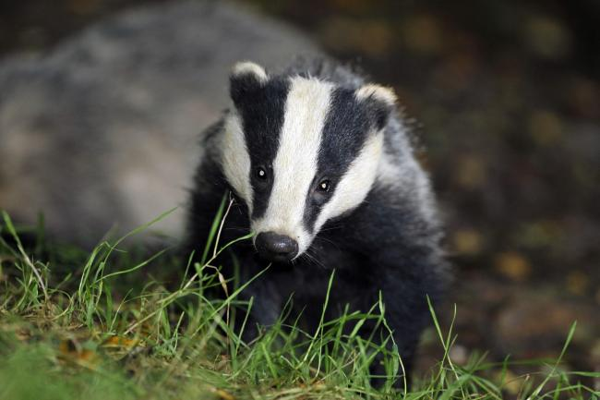
Tips
You have a limited amount of time so try to identify a key theme or story.
Think about how local residents are likely to value the site. What does McCormick what from the site. What aspects will they care about most?
Will your video emphasise benefits to humans? Or will you take a more traditional view?

Slide 10
Societal Pressure for Development
There are many strong arguments in support of conserving the Chalk Pits, but we should also consider the social benefits of alternative land management strategies.
For Task 2 you choose a different personas who are all in favour of changing the management of the Chalk Pits.
You will be required to consider alternative viewpoints and to examine ecological-social trade-offs.
Notes:
Split students into 4 groups A,B,C,D

Slide 11
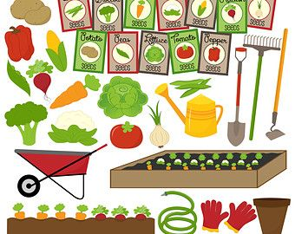
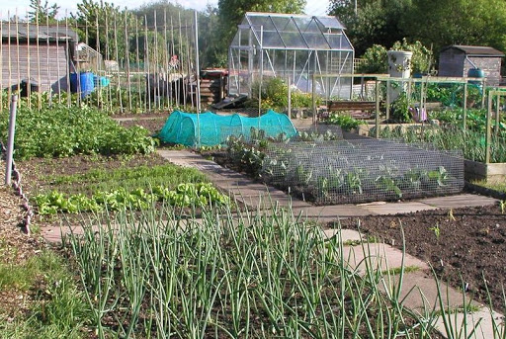
Group A: You are a keen to improve local food production with a lower carbon foot print
You are passionate about organic, local food production.
You are campaigning for the Chalk Pits to be converted into a new allotment site.

Slide 12
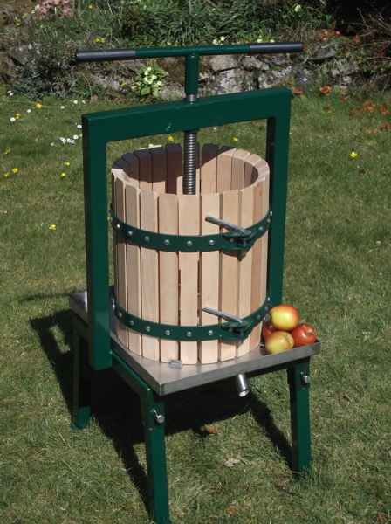
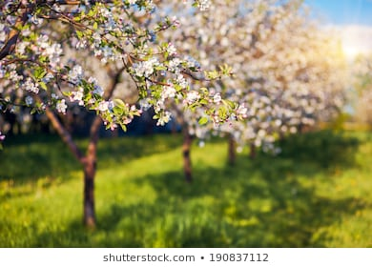
Group B: You are a producer of craft cider
Your prize-winning cider producer and you need more apples to meet the demand.
You are interested in developing the Chalk Pits into a new apple orchard.

Slide 13
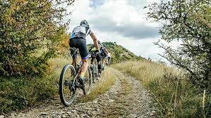
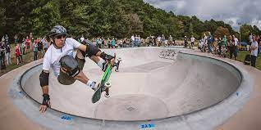
Group C: You are a youth worker and want improved facilities for young people to pursue interests

Slide 14
TASK 2 Letter to local councillor
You need to write a letter to your local councillor campaigning for the Chalk Pits to be converted to your personas preferred land-use type.
You will be assessed on your ability to build an evidence-based argument and should reference the primary literature to back up your statements.
The letter should be no more than 1,000 words (excluding references). It should be submitted to Turnitin by 14:00 on 7th April 2021.

Slide 15
How to get top marks
Build a balanced and evidence-based argument in favour of development.
Explain how the new land-use type is likely to influence biodiversity and ecosystem services (remember to consider cultural services).
Clearly summarise and reference relevant scientific literature.
Write professionally.
Adhere to formal letter writing standards.

